Slide 1

The Beginning of Life
as We Know It
Chapter 1 • Genesis 1-9

Slide 2
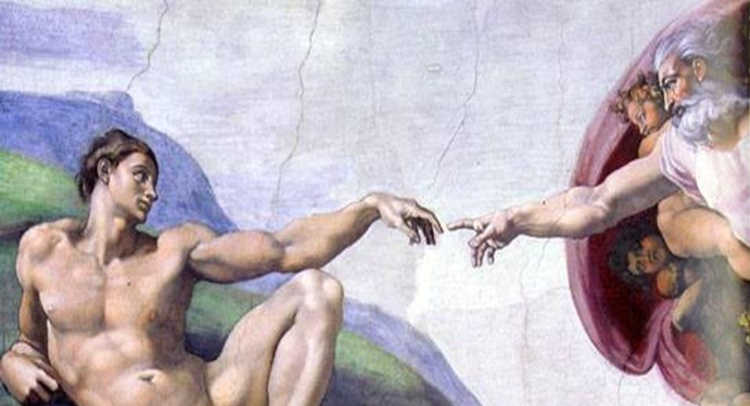
MICHELANGELO Buonarroti
Creation of Adam (detail)
1510
Fresco
Cappella Sistina, Vatican
Web Gallery of Art

Slide 3
What does the Bible and The Sistine Chapel have in common?
Each is a _________________________
AND a ____________________ of masterpieces.
masterpiece
collection
Both are telling _1_ primary story.

Slide 4
In the beginning God…

Slide 5
2 Foundation Facts of the Universe:
1. There is a ______.
2. _____ are not Him.
God
You

Slide 6
Big Bang
_________ #1: Creation!
In the beginning God created…
Days 1, 2, & 3 are _____________
Days 4, 5, & 6 are _____________
Day 7 – God created ________, Sabbath, and the idea of Sabbatical.
creation
creations
rest

Slide 7
God’s great ________ is poured into His creation of ___________!
passion
humanity
“Then God said, "Let us make man in our image, in our likeness, and let them rule over the fish of the sea and the birds of the air, over the livestock, over all the earth, and over all the creatures that move along the ground." 27 So God created man in his own image, in the image of God he created him; male and female he created them.”
(Genesis 1:26-27)

Slide 8
Big Bang
_________ #2: Rebellion!
Eden
The Garden of ______
2 Greatest Gifts
_______ Love
_____ Will
The Tale of Two _______: Genesis 2:9
Divine
Free
Trees

Slide 9
What does THE STORY (chapter 1) reveal to us?
#1. In the beginning God.
#2. God did it!
#3. God’s great _________ is poured into
His creation of _________________.
Genesis 1:26-27 … imago dei
Genesis 2:7 … a living soul
#4. God gives Divine ________ and Free ________.
“God, I love you _________!”
#5. God’s great desire and God’s ultimate effort
is to _______________ relationship!
Passion
Humanity
Love
Will
Back
Restore

